Slide 1
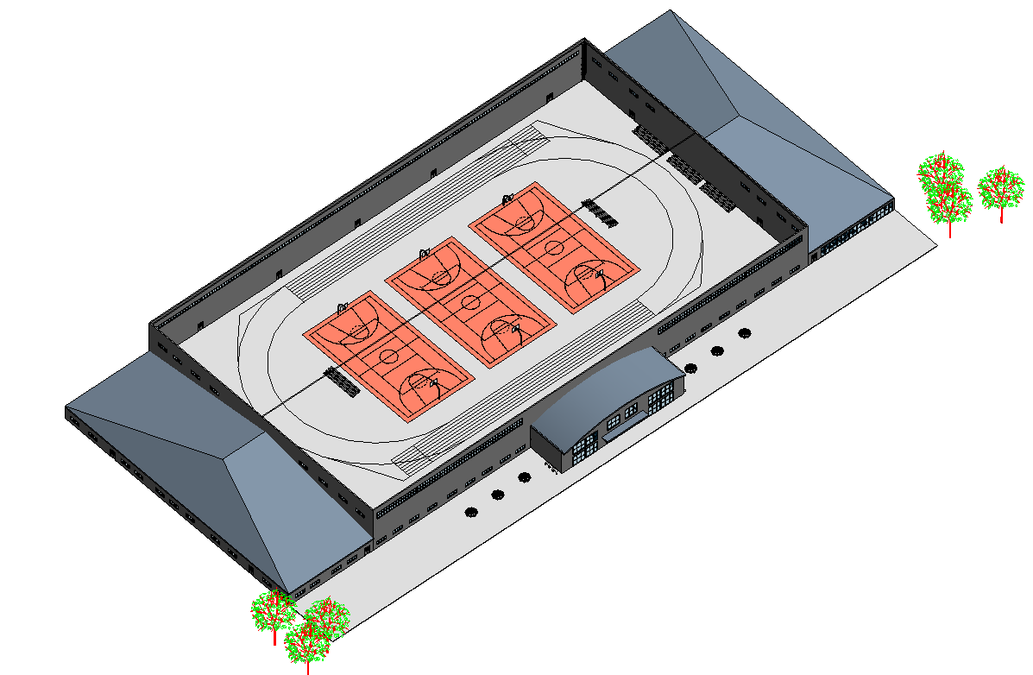
Student Wellness Center design
Presented by: Parke Martin, Zachary Karasek, Ryan Shirk

Slide 2
Problem statement
Elizabethtown College is looking to expand their wellness facilities. Our project was to propose a design for a new wellness facility that embodied mind, body, and spirit.

Slide 3
Site location
 | Thompson Gym | Between Soccer and Lacrosse Fields | Behind Soccer Field | Off Campus Location
Workable land | - | + | + | D
New Renovations | - | + | - | A
Space needed | - | + | + | T
Accessibility | + | + | + | U
Aesthetics | - | - | + | M
 | 1 | 4 | 4

Slide 4
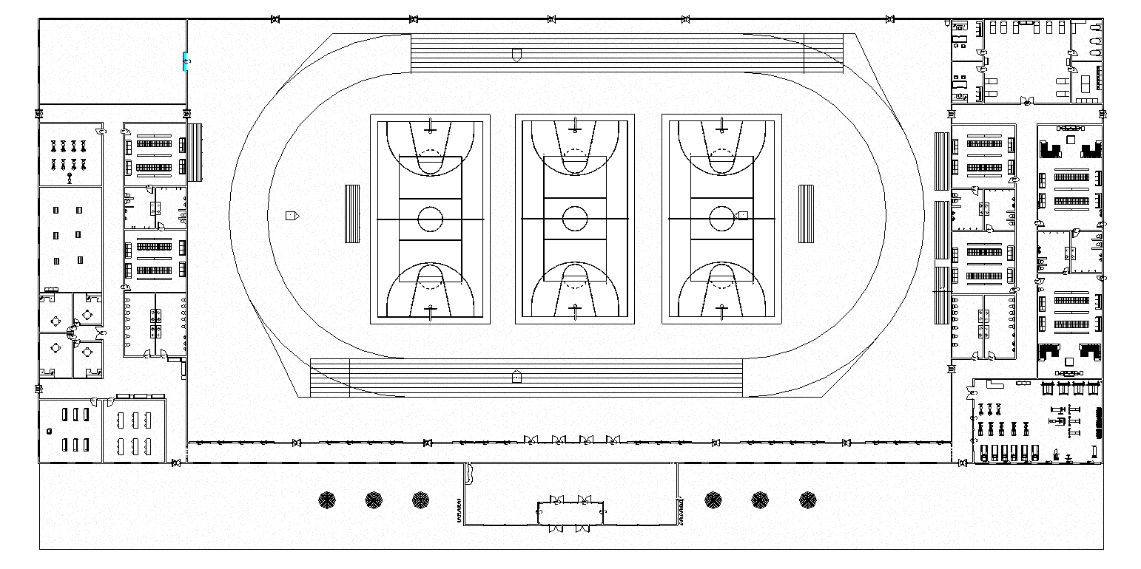
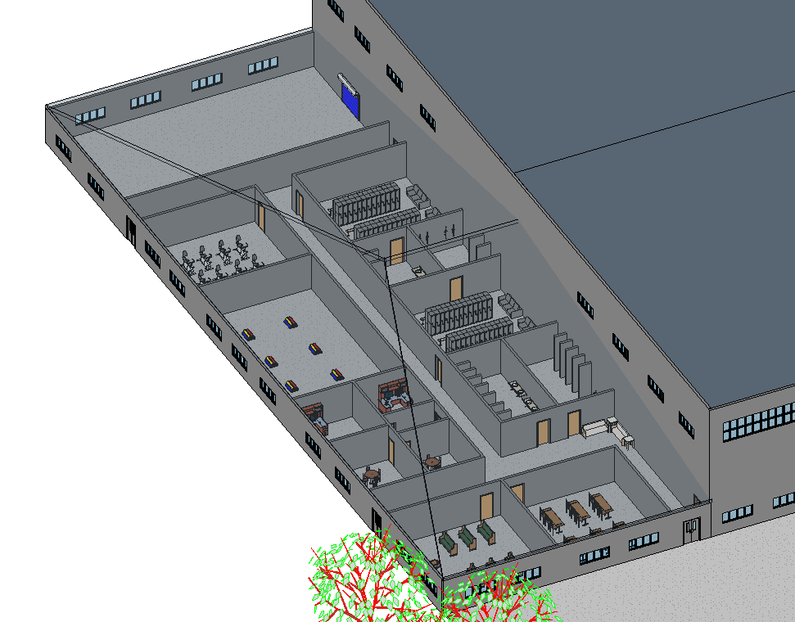
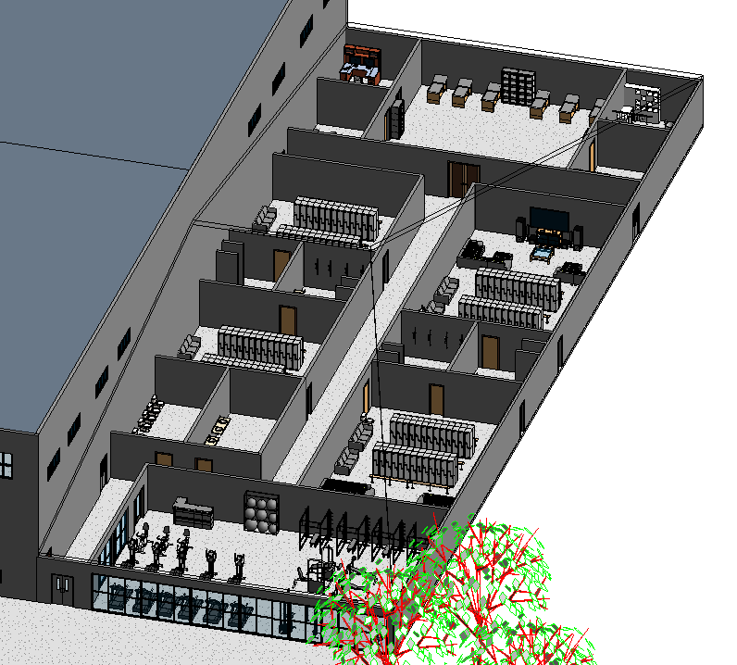
Design

Slide 5
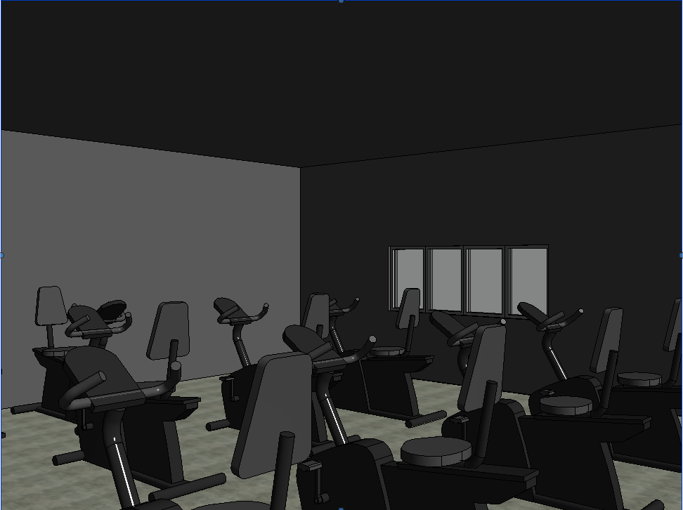
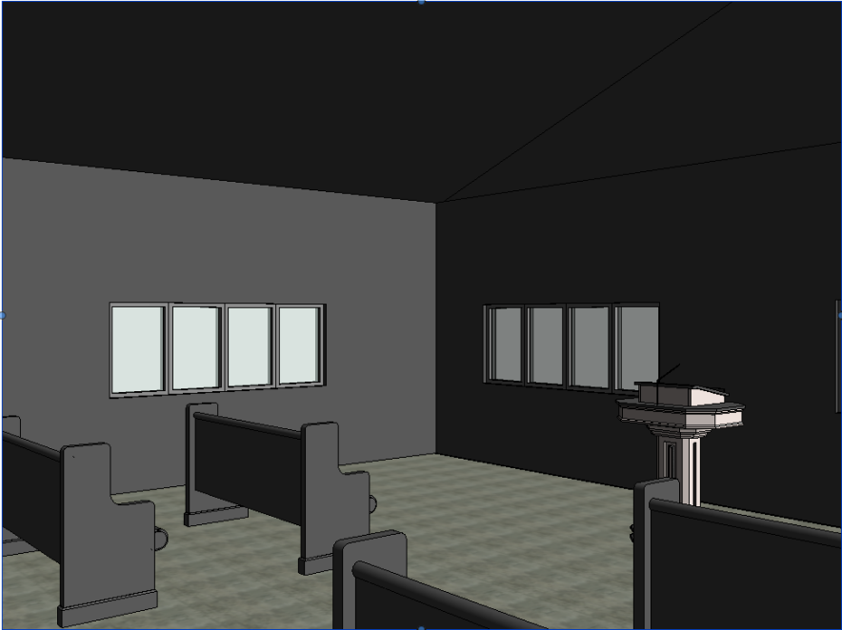
Spirit and Mind
Basic Needs
Athletic class rooms
Social hub (inviting)
Counseling
Terrace
Want We Provided
Athletic class rooms
Two lounges
4 separate offices
Terrace
Yoga room and spin class
Prayer Room

Slide 6
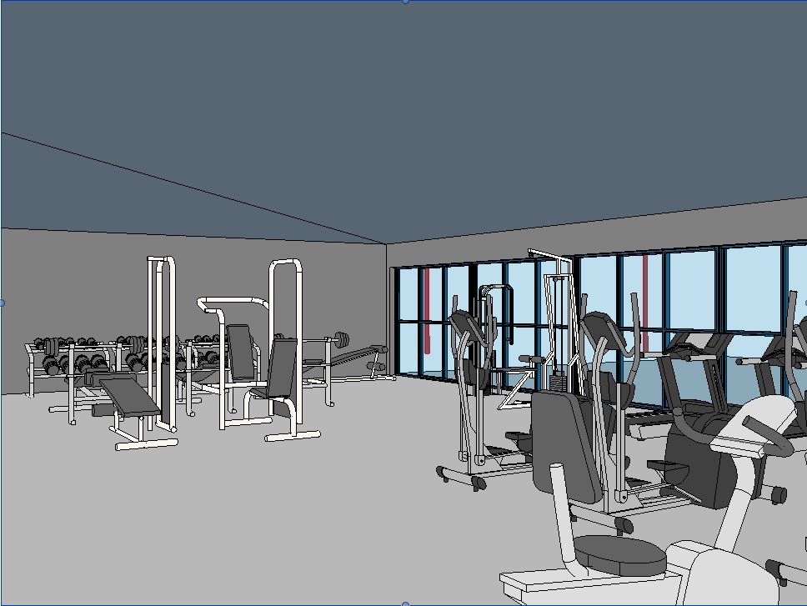
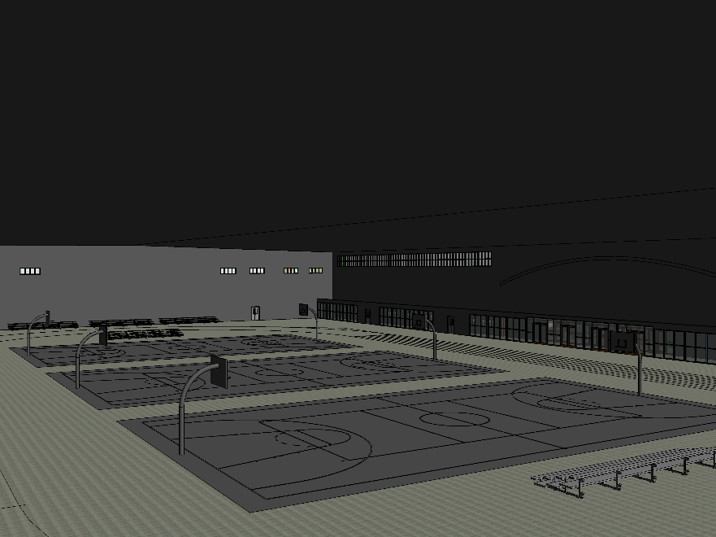
Athletic Facilities
Basic needs
Field House (3 courts)
Fitness Center
4-8 Locker Rooms
Want We Provided
3 courts and 200 m track
Weight Room
6 Locker Rooms
Training Room

Slide 7
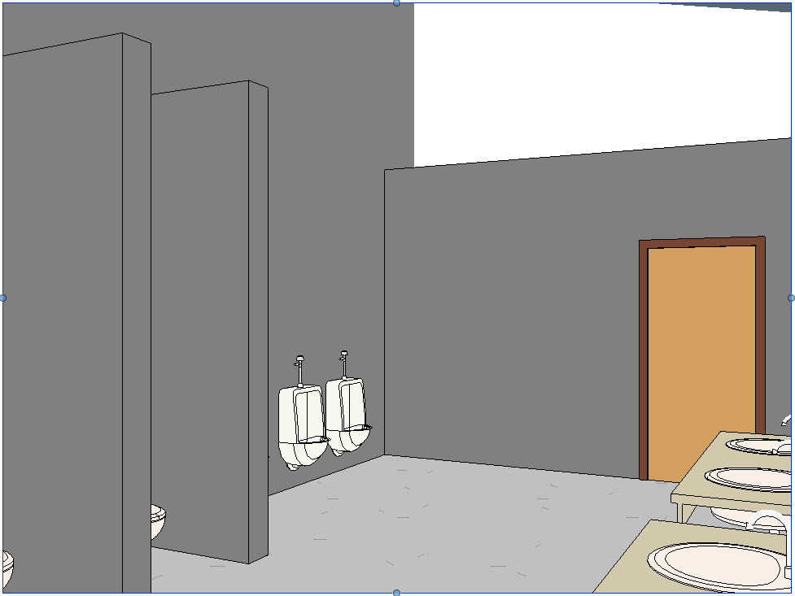
facility management
Storage
4 public bathrooms
6 private bathrooms
(one for each locker room)
2800 square feet of storage

Slide 9
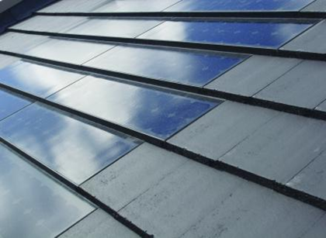
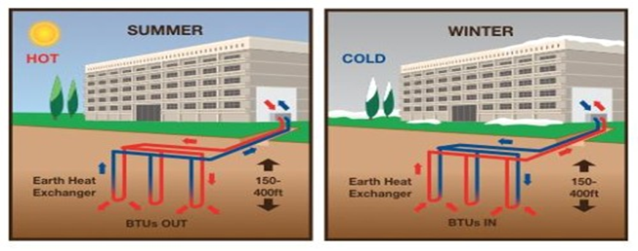
Sustainable features
Green Roof:
This will allow use to collect and use rainwater for the buildings pluming
This will also provide insulation for the main room in the building
Solar Shingles:
This will help with providing energy for the building along with providing aesthetics
Geothermal heat:
Takes advantage of the earth’s constant core temperature, using it to heat and cool the building..
 | Green Roof | Blue Sheet Metal | Solar Roof | Shingles
Aesthetics | + | + | + | D
Sustainability | + | - | + | A
Cost of Material | + | + | - | T
Cost of Installment | - | + | - | U
Life-span | + | + | + | M
 | 4 | 4 | 3

Slide 10
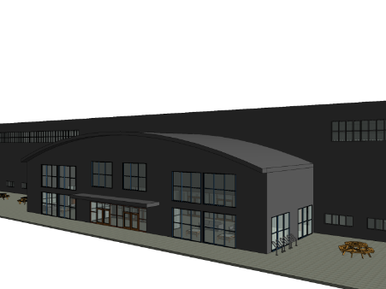
What this would do for the college
Student Health
College can provide more E-fit events with larger space
Entices more students to use facilities that will be provided in the building
Gives students a space to come to reflex and work on their mental health
Gives students a space to reflex on their own religion in a non-judgmental space
Student Academics
Provide room which could be used to possible add new majors along the line of sports
Bring more students to the college
Outside usage
Bring money to college when facilities are not being used by the students, staff, or athletics
Sustainability
Environmental focus of the college can be shown

Slide 11
Conclusion
With the conclusion of this project we have achieved a new field house for the Elizabethtown College campus that is not only functional, but sustainable, As well as tying together the mind, body, and spirit of the college campus.

